Slide 1


INGRESS
Insight to Ingress Controllers & Resources by anishrana2001

Slide 2
Agenda
Refresher of Kubernetes services
ClusterIP
NodePort
LoadBalancer
what is Ingress
Why we use Ingress
Type of Ingress Controller
What is Ingress Resources
How to implement Host-based, Path-based and terminate SSL traffic

Slide 3
01 NOW WE WILL TALK ABOUT
ClusterIP

Slide 4
apiVersion: apps/v1 kind: Deployment metadata: labels: app: devops-wala.com-cka name: devops-wala.com-cka spec: replicas: 2 selector: matchLabels: app: devops-wala.com-cka strategy: {} template: metadata: labels: app: devops-wala.com-cka spec: containers: - name: devops-wala-cka image: nginx
ports:
- containerPort: 80 volumeMounts: - name: cka-page mountPath: /usr/share/nginx/html/ volumes: - name: cka-page configMap: name: cka-page
apiVersion: v1 kind: Service metadata: name: nginx-deployment-cka-clusterip spec: selector: app: devops-wala.com-cka type: ClusterIP ports: - port: 8080 protocol: TCP targetPort: 80

Slide 5

kubectl get pods -o wide
NAME READY STATUS RESTARTS AGE IP NODE
devops-wala.com-cka-568f44f7c7-z45l9 1/1 Running 0 19m 172.16.14.114 workernode2.example.com
devops-wala.com-cka-568f44f7c7-wwcp8 1/1 Running 0 19m 172.16.133.181 workernode1.example.com
kubectl get service/nginx-deployment-cka-clusterip
NAME TYPE CLUSTER-IP EXTERNAL-IP PORT(S) AGE
nginx-deployment-cka-clusterip ClusterIP 10.105.111.222 <none> 8080/TCP 16m
kubectl get service/nginx-deployment-cka-clusterip -o yaml
apiVersion: v1
kind: Service
metadata:
name: nginx-deployment-cka-clusterip
namespace: default
resourceVersion: "234197"
uid: 9651bcc5-312f-4dc7-9e63-e12164ad90f5
spec:
clusterIP: 10.105.111.222
clusterIPs:
- 10.105.111.222
internalTrafficPolicy: Cluster
ipFamilies:
- IPv4
ipFamilyPolicy: SingleStack
ports:
- port: 8080
protocol: TCP
targetPort: 80
selector:
app: devops-wala.com-cka
sessionAffinity: None
type: ClusterIP
status:
loadBalancer: {}
spec.clusterIP
10.105.111.222
spec.ports[0].port
Service
nginx-deployment-cka-clusterip
8080
spec.ports[0].targetPort
80
80
172.16.14.114
172.16.133.181
Workernode1
Workernode2
Kubernetes Cluster

Slide 6
02 NOW WE WILL TALK ABOUT
nodePort

Slide 7
apiVersion: apps/v1 kind: Deployment metadata: labels: app: devops-wala.com-cka name: devops-wala.com-cka spec: replicas: 2 selector: matchLabels: app: devops-wala.com-cka strategy: {} template: metadata: labels: app: devops-wala.com-cka spec: containers: - name: devops-wala-cka image: nginx
ports:
- containerPort: 80 volumeMounts: - name: cka-page mountPath: /usr/share/nginx/html/ volumes: - name: cka-page configMap: name: cka-page
cat <<EOF>> nginx-deployment-cka-nodeport.yaml
apiVersion: v1
kind: Service
metadata:
name: nginx-deployment-cka-nodeport
spec:
selector:
app: devops-wala.com-cka
type: NodePort
ports:
- port: 8080
protocol: TCP
targetPort: 80
nodePort: 31001
EOF
kubectl apply -f nginx-deployment-cka-nodeport.yaml

Slide 8
kubectl get service nginx-deployment-cka-nodeport
NAME TYPE CLUSTER-IP EXTERNAL-IP PORT(S) AGE
nginx-deployment-cka-nodeport NodePort 10.99.58.32 <none> 8080:31001/TCP 47s
kubectl get service nginx-deployment-cka-nodeport -o yaml
apiVersion: v1
kind: Service
metadata:
annotations:
kubectl.kubernetes.io/last-applied-configuration: |
{"apiVersion":"v1","kind":"Service","metadata":{"annotations":{},"name":"nginx-deployment-cka-nodeport","namespace":"default"},"spec":{"ports":[{"nodePort":31001,"port":8080,"protocol":"TCP","targetPort":80}],"selector":{"app":"devops-wala.com-cka"},"type":"NodePort"}}
creationTimestamp: "2024-04-14T06:01:47Z"
name: nginx-deployment-cka-nodeport
namespace: default
resourceVersion: "281624"
uid: 75921dbc-c2c7-41d4-9b37-80b3de50f8bd
spec:
clusterIP: 10.99.58.32
clusterIPs:
- 10.99.58.32
externalTrafficPolicy: Cluster
internalTrafficPolicy: Cluster
ipFamilies:
- IPv4
ipFamilyPolicy: SingleStack
ports:
- nodePort: 31001
port: 8080
protocol: TCP
targetPort: 80
selector:
app: devops-wala.com-cka
sessionAffinity: None
type: NodePort
status:
loadBalancer: {}
spec.ports[0].port
31001
31001
Node / VM IP
192.168.1.32
192.168.1.33
spec.ports[0].port
cluster IP Service
8080
10.99.58.32
spec.clusterIP
spec.ports[0].targetPort
80
80
172.16.14.114
172.16.133.181
Workernode1
Workernode2
Kubernetes Cluster

Slide 9
03 NOW WE WILL TALK ABOUT
loadBalancer

Slide 10
apiVersion: apps/v1 kind: Deployment metadata: labels: app: devops-wala.com-cka name: devops-wala.com-cka spec: replicas: 2 selector: matchLabels: app: devops-wala.com-cka strategy: {} template: metadata: labels: app: devops-wala.com-cka spec: containers: - name: devops-wala-cka image: nginx
ports:
- containerPort: 80 volumeMounts: - name: cka-page mountPath: /usr/share/nginx/html/ volumes: - name: cka-page configMap: name: cka-page
cat <<EOF>> nginx-deployment-cka-lb.yaml
apiVersion: v1
kind: Service
metadata:
name: nginx-deployment-cka-lb
spec:
selector:
app: devops-wala.com-cka
type: LoadBalancer
ports:
- port: 8080
protocol: TCP
targetPort: 80
EOF
kubectl apply -f nginx-deployment-cka-lb.yaml

Slide 11
kubectl get service/nginx-deployment-cka-lb -o yaml
apiVersion: v1
kind: Service
metadata:
annotations:
kubectl.kubernetes.io/last-applied-configuration: |
{"apiVersion":"v1","kind":"Service","metadata":{"annotations":{},"name":"nginx-deployment-cka-lb","namespace":"default"},"spec":{"ports":[{"port":8080,"protocol":"TCP","targetPort":80}],"selector":{"app":"devops-wala.com-cka"},"type":"LoadBalancer"}}
name: nginx-deployment-cka-lb
namespace: default
resourceVersion: "297159"
uid: 3a1da997-ed47-4525-bcb2-467aecbd2f92
spec:
allocateLoadBalancerNodePorts: true
clusterIP: 10.108.189.251
clusterIPs:
- 10.108.189.251
externalTrafficPolicy: Cluster
internalTrafficPolicy: Cluster
ipFamilies:
- IPv4
ipFamilyPolicy: SingleStack
ports:
- nodePort: 30794
port: 8080
protocol: TCP
targetPort: 80
selector:
app: devops-wala.com-cka
sessionAffinity: None
type: LoadBalancer
status:
loadBalancer: {}
kubectl get service/nginx-deployment-cka-lb
NAME TYPE CLUSTER-IP EXTERNAL-IP PORT(S) AGE
nginx-deployment-cka-lb LoadBalancer 10.108.189.251 <pending> 8080:30794/TCP 9s

Slide 12
kubectl apply -f https://raw.githubusercontent.com/metallb/metallb/v0.13.9/config/manifests/metallb-native.yaml
cat <<EOF>> l2advertise.yaml
apiVersion: metallb.io/v1beta1
kind: L2Advertisement
metadata:
name: example
namespace: metallb-system
EOF
kubectl create -f l2advertise.yaml
cat <<EOF>> IPAddressPool.yaml
apiVersion: metallb.io/v1beta1
kind: IPAddressPool
metadata:
name: first-pool
namespace: metallb-system
spec:
addresses:
- 192.168.1.100-192.168.1.110
EOF
kubectl create -f IPAddressPool.yaml

Slide 13
kubectl get service/nginx-deployment-cka-lb -o yaml
apiVersion: v1
kind: Service
metadata:
annotations:
kubectl.kubernetes.io/last-applied-configuration: |
{"apiVersion":"v1","kind":"Service","metadata":{"annotations":{},"name":"nginx-deployment-cka-lb","namespace":"default"},"spec":{"ports":[{"port":8080,"protocol":"TCP","targetPort":80}],"selector":{"app":"devops-wala.com-cka"},"type":"LoadBalancer"}}
metallb.universe.tf/ip-allocated-from-pool: first-pool
name: nginx-deployment-cka-lb
namespace: default
resourceVersion: "301519"
uid: 3a1da997-ed47-4525-bcb2-467aecbd2f92
spec:
allocateLoadBalancerNodePorts: true
clusterIP: 10.108.189.251
clusterIPs:
- 10.108.189.251
externalTrafficPolicy: Cluster
internalTrafficPolicy: Cluster
ipFamilies:
- IPv4
ipFamilyPolicy: SingleStack
ports:
- nodePort: 30794
port: 8080
protocol: TCP
targetPort: 80
selector:
app: devops-wala.com-cka
sessionAffinity: None
type: LoadBalancer
status:
loadBalancer:
ingress:
- ip: 192.168.1.100

Slide 14

8080
192.168.1.100
spec.ports[0].port
31001
31001
Node / VM IP
192.168.1.32
192.168.1.33
spec.ports[0].port
cluster IP Service
8080
10.99.58.32
spec.clusterIP
spec.ports[0].targetPort
80
80
172.16.133.181
172.16.14.114
Workernode1
Workernode2
Kubernetes Cluster

Slide 15
8080
8081
192.168.1.101
192.168.1.100
30085
31001
31001
30085
192.168.1.32
192.168.1.33
8080
10.99.58.32
cluster IP Service
80
80
172.16.133.181
172.16.14.114
cluster IP Service
10.107.86.175
8081
80
80
172.16.133.154
172.16.14.121
Workernode1
Workernode2
Kubernetes Cluster

Slide 16
Downside of LoadBalancer services
The LoadBalancer Service is used for L4 load balancing
7 Application Layer
6 Presentation Layer
HTTP or HTTPS
HTTPS Traffic Termination
Name-based Virtual Hosting
5 Session layer
4 Transport Layer
L7 Load balancer
3 Network Layer
2 Data Link Layer
1 Physical Layer

Slide 17
Ingress

Slide 18
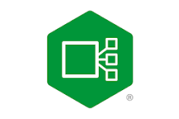




Deploy
Ingress Controller
NGINX
HAPROXY
Istio
Envoy
Configure Rule
Ingress Resources

Slide 19
Ingress Controller
Its not comes by default when we create a Kubernetes cluster.
Ingress controller deployed as a DaemonSet or a Deployment.
Ingress object is used for defining the routing and balancing rules only.
It is responsible for processing the Ingress objects & routing rules.
The NGINX Ingress Controller is a Kubernetes component for routing external traffic to Kubernetes pods. It offers powerful features and benefits for managing ingress traffic effectively.
HTTP or HTTPS
HTTPS Traffic Termination
Name-based Virtual Hosting
L7 Load balancer

Slide 20
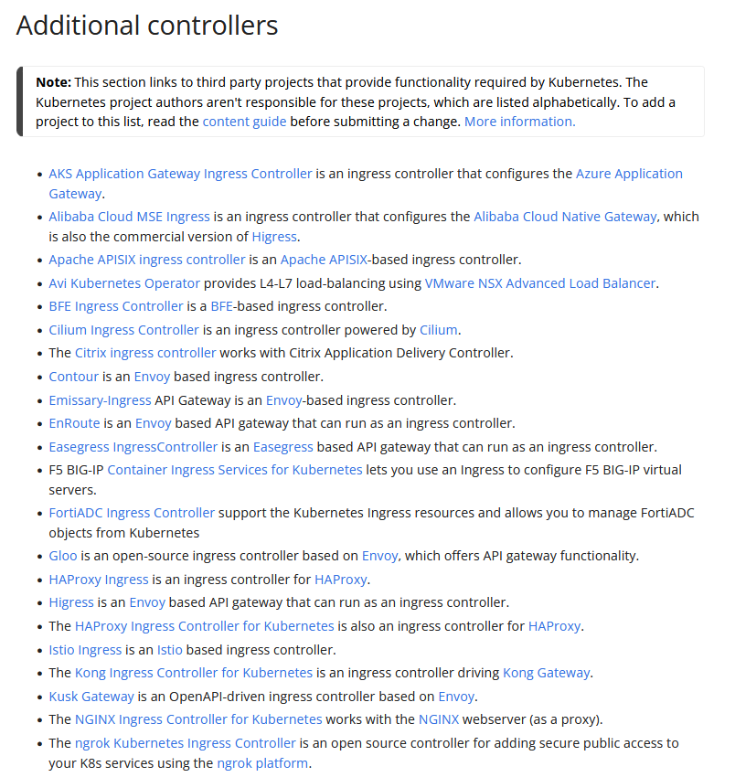
https://kubernetes.io/docs/concepts/services-networking/ingress-controllers/

Slide 21
example.com
devops-wala.com
course.devops-wala.com
Host-Based Example
www.devops-wala.com
www.devops-wala.com/cka
www.devops-wala.com/ckad
Path-Based Example
SSL Example
https ➔ http

Slide 22
Installation
of
NGINX Controller

Slide 23
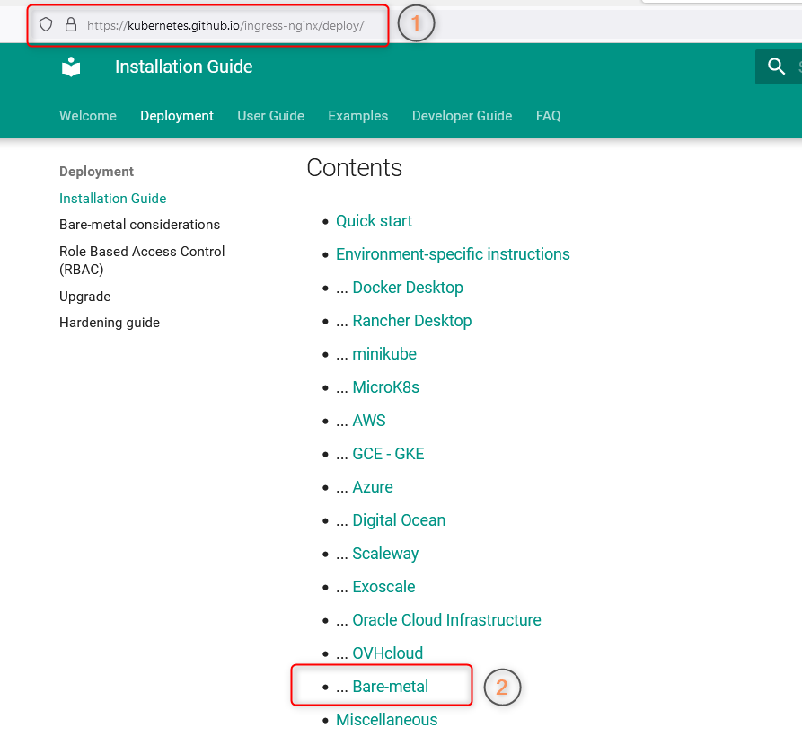

Slide 24
kubectl apply -f https://raw.githubusercontent.com/kubernetes/ingress-nginx/controller-v1.10.0/deploy/static/provider/cloud/deploy.yaml
Namespace: ingress-nginx
ServiceAccount: ingress-nginx
[root@master1 ~]# kubectl -n ingress-nginx describe serviceaccounts ingress-nginx
Name: ingress-nginx
Namespace: ingress-nginx
Labels: app.kubernetes.io/component=controller
app.kubernetes.io/instance=ingress-nginx
app.kubernetes.io/name=ingress-nginx
app.kubernetes.io/part-of=ingress-nginx
app.kubernetes.io/version=1.10.0
Annotations: <none>
Image pull secrets: <none>
Mountable secrets: <none>
Tokens: <none>
Events: <none>

Slide 25
kubectl apply -f https://raw.githubusercontent.com/kubernetes/ingress-nginx/controller-v1.10.0/deploy/static/provider/cloud/deploy.yaml
[root@master1 ~]# kubectl -n ingress-nginx get configmaps ingress-nginx-controller
NAME DATA AGE
ingress-nginx-controller 1 9m6s
[root@master1 ~]# kubectl -n ingress-nginx describe configmaps ingress-nginx-controller
Name: ingress-nginx-controller
Namespace: ingress-nginx
Labels: app.kubernetes.io/component=controller
app.kubernetes.io/instance=ingress-nginx
app.kubernetes.io/name=ingress-nginx
app.kubernetes.io/part-of=ingress-nginx
app.kubernetes.io/version=1.10.0
Annotations: <none>
Data
====
allow-snippet-annotations:
----
false
BinaryData
====
Events:
Type Reason Age From Message
---- ------ ---- ---- -------
Normal CREATE 8m45s nginx-ingress-controller ConfigMap ingress-nginx/ingress-nginx-controller
[root@master1 ~]#
Namespace: ingress-nginx
ServiceAccount: ingress-nginx
ConfigMap: ingress-nginx-controller

Slide 26
kubectl apply -f https://raw.githubusercontent.com/kubernetes/ingress-nginx/controller-v1.10.0/deploy/static/provider/cloud/deploy.yaml
[root@master1 ~]# kubectl describe clusterrole/ingress-nginx
Name: ingress-nginx
Labels: app.kubernetes.io/instance=ingress-nginx
app.kubernetes.io/name=ingress-nginx
app.kubernetes.io/part-of=ingress-nginx
app.kubernetes.io/version=1.10.0
Annotations: <none>
PolicyRule:
Resources Non-Resource URLs Resource Names Verbs
--------- ----------------- -------------- -----
events [] [] [create patch]
services [] [] [get list watch]
ingressclasses.networking.k8s.io [] [] [get list watch]
ingresses.networking.k8s.io [] [] [get list watch]
nodes [] [] [list watch get]
endpointslices.discovery.k8s.io [] [] [list watch get]
configmaps [] [] [list watch]
endpoints [] [] [list watch]
namespaces [] [] [list watch]
pods [] [] [list watch]
secrets [] [] [list watch]
leases.coordination.k8s.io [] [] [list watch]
ingresses.networking.k8s.io/status [] [] [update]
[root@master1 ~]# kubectl describe clusterrolebinding/ingress-nginx
Name: ingress-nginx
Labels: app.kubernetes.io/instance=ingress-nginx
app.kubernetes.io/name=ingress-nginx
app.kubernetes.io/part-of=ingress-nginx
app.kubernetes.io/version=1.10.0
Annotations: <none>
Role:
Kind: ClusterRole
Name: ingress-nginx
Subjects:
Kind Name Namespace
---- ---- ---------
ServiceAccount ingress-nginx ingress-nginx
Namespace: ingress-nginx
ServiceAccount: ingress-nginx
ConfigMap: ingress-nginx-controller
ClusterRole ; ClusterRoleBinding

Slide 27
[root@master1 ~]# kubectl -n ingress-nginx describe role/ingress-nginx
Name: ingress-nginx
Labels: app.kubernetes.io/component=controller
app.kubernetes.io/instance=ingress-nginx
app.kubernetes.io/name=ingress-nginx
app.kubernetes.io/part-of=ingress-nginx
app.kubernetes.io/version=1.10.0
Annotations: <none>
PolicyRule:
Resources Non-Resource URLs Resource Names Verbs
--------- ----------------- -------------- -----
events [] [] [create patch]
leases.coordination.k8s.io [] [] [create]
configmaps [] [] [get list watch]
endpoints [] [] [get list watch]
pods [] [] [get list watch]
secrets [] [] [get list watch]
services [] [] [get list watch]
ingressclasses.networking.k8s.io [] [] [get list watch]
ingresses.networking.k8s.io [] [] [get list watch]
leases.coordination.k8s.io [] [ingress-nginx-leader] [get update]
namespaces [] [] [get]
endpointslices.discovery.k8s.io [] [] [list watch get]
ingresses.networking.k8s.io/status [] [] [update]
[root@master1 ~]# kubectl -n ingress-nginx describe rolebinding/ingress-nginx
Name: ingress-nginx
Labels: app.kubernetes.io/component=controller
app.kubernetes.io/instance=ingress-nginx
app.kubernetes.io/name=ingress-nginx
app.kubernetes.io/part-of=ingress-nginx
app.kubernetes.io/version=1.10.0
Annotations: <none>
Role:
Kind: Role
Name: ingress-nginx
Subjects:
Kind Name Namespace
---- ---- ---------
ServiceAccount ingress-nginx ingress-nginx
Namespace: ingress-nginx
ServiceAccount: ingress-nginx
ConfigMap: ingress-nginx-controller
ClusterRole ; ClusterRoleBinding
Role ; RoleBinding

Slide 28
Namespace: ingress-nginx
ServiceAccount: ingress-nginx
ConfigMap: ingress-nginx-controller
ClusterRole ; ClusterRoleBinding
Role ; RoleBinding
webhook

Slide 29
Ingress Basic Example
Ingress Controller
Ingress Resource
ClusterIP service
Deployment
POD
1
POD
2
Node1
Node2
Kubernetes Cluster

Slide 30
https://kubernetes.github.io/ingress-nginx/deploy/

Slide 31
01 NOW WE WILL TALK ABOUT
Path-based

Slide 32

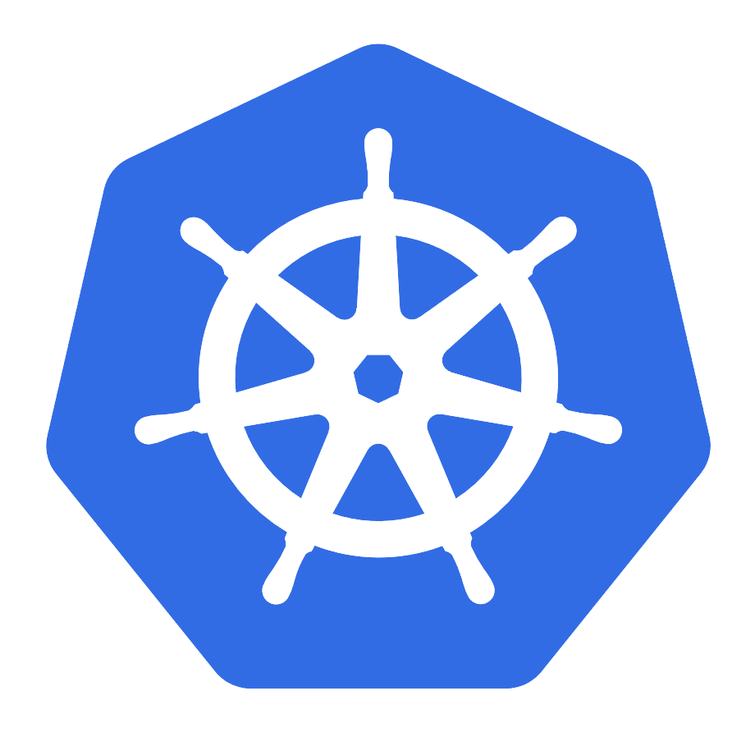






Devops-wala.com
Devops-wala.com/ckad
Ingress Resource
/cka
cka exam
ckad exam
Kubernetes-course

Slide 33
02 NOW WE WILL TALK ABOUT
Host-based

Slide 34
Devops-wala.com
www.example.com
Ingress Resource
example
Kubernetes-course

Slide 35
03 NOW WE WILL TALK ABOUT
SSL-based

Slide 36
Obtaining Kubernetes Ingress SSL/TLS Certificates
The basic requirement for ingress TLS is a TLS/SSL certificate.
TLS certificate created and signed by our own Certificate Authority.
This option is more useful for development environments where you can share the rootCA
with the team so that browsers can trust the certificate. I will over this option.
You need to buy an SSL certificate from a well-known certificate
authority trusted by browsers & operating systems for production use cases.
Use Letsencrpt Certificate: Letsencrypt is a non-profit trusted certificate authority that
provides free TLS certificates.
Self-Signed Certificates:
Purchase an SSL Certificate:

Slide 37
Generate a self-signed certificate and private key
openssl req -x509 -sha256 -nodes -days 365 -newkey rsa:2048 –keyout
tls.key -out tls.crt -subj “/CN=nginxsvc/O=nginxsvc”
kubectl create secret tls tls-secret --key tls.key --cert tls.crt

Slide 38



https://devops-wala.com
LoadBalancer
Encrypted traffic
Nginx Controller
kubectl -n ingress-nginx get pods
NAME READY STATUS RESTARTS AGE
ingress-nginx-admission-create-wnqvj 0/1 Completed 0 2d
ingress-nginx-admission-patch-lrzb4 0/1 Completed 0 2d
ingress-nginx-controller-548f6d66cc-q9r4p 1/1 Running 1 (70m ago) 2d
Ingress Resource
Kubernetes-course

Slide 39
https://devops-wala.com
LoadBalancer
Encrypted traffic
Nginx Controller
kubectl -n ingress-nginx get pods
NAME READY STATUS RESTARTS AGE
ingress-nginx-admission-create-wnqvj 0/1 Completed 0 2d
ingress-nginx-admission-patch-lrzb4 0/1 Completed 0 2d
ingress-nginx-controller-548f6d66cc-q9r4p 1/1 Running 1 (70m ago) 2d
kubectl -n ingress-nginx exec -it pod/ingress-nginx-controller-548f6d66cc-q9r4p -- cat /etc/nginx/nginx.conf
ssl_certificate_by_lua_block {
certificate.call()
}
The certificates are not listed in the nginx.conf file.
The ingress controller loads the certs and keys into a shared memory area when it processes the Ingress definitions and this lua script in nginc.conf file gets the cert from that cache when a request is processed by nginx.
Kubernetes-course

Slide 40
https://devops-wala.com
LoadBalancer
kubectl create secret tls tls-secret --key tls.key --cert tls.crt
Encrypted traffic
Nginx Controller
spec:
tls:
- hosts:
- devops-wala.com
secretName: tls-secret
Ingress Resource
Kubernetes-course

Slide 41
https://devops-wala.com
Encrypted traffic
LoadBalancer
Nginx Controller
Ingress Resource
Kubernetes-course

Slide 42
04 NOW WE WILL TALK ABOUT
Advance

